Slide 1
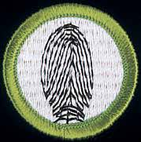
Fingerprinting Merit Badge
“Fingerprints cannot lie,
but liars can make fingerprints.”
—Unknown
Troop 344 & 9344
Pemberville, OH

Slide 2
Fingerprinting Merit Badge Requirements
Give a short history of fingerprinting. Tell the difference between civil and criminal identification.
Explain the difference between the automated fingerprint identification systems (AFIS) now used by some law enforcement agencies and the biometric fingerprint systems used to control access to places like buildings, airports, and computer rooms.
Do the following:
Name the surfaces of the body where friction or papillary ridges are found.
Name the two basic principles supporting the science of fingerprints and give a brief explanation of each principle.
Explain what it takes to positively identify a person using fingerprints.

Slide 3
Fingerprinting Merit Badge Requirements
Take a clear set of prints using ONE of the following methods.
Make both rolled and plain impressions. Make these on an 8-by-8-inch fingerprint identification card, available from your local police department or your counselor.
Using clear adhesive tape, a pencil, and plain paper, record your own fingerprints or those of another person.
Show your merit badge counselor you can identify the three basic types of fingerprint patterns and their subcategories. Using your own hand, identify the types of patterns you see.

Slide 4
Fingerprinting Merit Badge

Slide 5
Requirement #1
Give a short history of fingerprinting. Tell the difference between civil and criminal identification.

Slide 6
Fingerprint History
1888: Sir Francis Galton and Sir Edward Henry developed the fingerprint classification system that is still in use in the U.S.
1684: Dr. Nehemiah’s paper describing the patterns he saw on human hands under a microscope, including the presence of ridges.
Prehistory: Early potters identify their works with an impressed fingerprint.
1856: Sir William Herschel He began the collection of fingerprints and noted they were not altered by age.
1892: Juan Vucetich made the first criminal fingerprint identification
Prehistory
300 BC
1684
1788
1823
1856
1883
1888
1892
1896
1883: Alphonse Bertillon created a way to identify criminals to identify repeat offenders.
300 BC: The Chinese sign legal documents with fingerprints.
1788: Johann Mayer noted that the arrangement of skin ridges is never duplicated in two persons.
1896: Sir Edward Henry created a system that divided fingerprints into groups. Along with notations about individual characteristics, all ten fingerprints were imprinted on a card.
1823: John Purkinje establishes nine basic fingerprint patterns and rules for classifying them.

Slide 7
Juan Vucetich’s Early Fingerprints
In 1892, two boys were brutally murdered in the village of Necochea, near Buenos Aires, Argentina.
Initially, suspicion fell on a man named Velasquez, a suitor of the children's mother, Francisca Rojas.
Even after torture, the police could not get him to confess.
Investigators found a bloody fingerprint at the crime scene and contacted Juan Vucetich, who was developing a system of fingerprint identification for police use.
Vucetich compared the fingerprints of Rojas and Velasquez with the bloody fingerprint.

Slide 8
Juan Vucetich’s Early Fingerprints
Francisca Rojas had denied touching the bloody bodies, but the fingerprint matched one of hers.
Confronted with the evidence, she confessed—the first successful use of fingerprint identification in a murder investigation.
After the Rojas case, Vucetich improved his fingerprint system, which he called "comparative dactyloscopy."
Adopted by the province of Buenos Aires in 1903, it spread rapidly throughout the Spanish-speaking world.
Notes:
In 1892, two boys were brutally murdered in the village of Necochea, near Buenos Aires, Argentina. Initially, suspicion fell on a man named Velasquez, a suitor of the children's mother, Francisca Rojas. But even after torture, the police could not get him to confess.
Investigators found a bloody fingerprint at the crime scene and contacted Juan Vucetich, who was developing a system of fingerprint identification for police use. Vucetich compared the fingerprints of Rojas and Velasquez with the bloody fingerprint. Francisca Rojas had denied touching the bloody bodies, but the fingerprint matched one of hers.
Confronted with the evidence, she confessed—the first successful use of fingerprint identification in a murder investigation. After the Rojas case, Vucetich improved his fingerprint system, which he called "comparative dactyloscopy." Adopted by the province of Buenos Aires in 1903, it spread rapidly throughout the Spanish-speaking world.

Slide 9
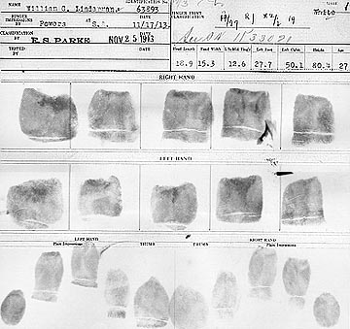
An Early Example of a Ten Card

Slide 10
Civil vs. Criminal Fingerprint Identification
Civil fingerprints are mostly of individuals who have served or are serving in the U.S. military or have been or are employed by the federal government.
In the United States, the FBI manages a fingerprint identification system and database which holds the fingerprints of criminal record subjects

Slide 11
Requirement #2
Explain the difference between the automated fingerprint identification systems (AFIS) now used by some law enforcement agencies and the biometric fingerprint systems used to control access to places like buildings, airports, and computer rooms.

Slide 12
Automated Fingerprint Identification System (AFIS)
In the early 1970s, the FBI and the National Bureau of Standards conducted feasibility research for establishing an automated fingerprint identification process.
AFIS allows law enforcement agencies to conduct comparisons of applicant and suspect fingerprints with literally thousands or millions of file prints in a matter of minutes.

Slide 13
Automated Fingerprint Identification System (AFIS)
AFIS has two major duties
First is performing the functions of classifying searching and matching prints
Second is the storage and retrieval of fingerprints data
In July 1999, law enforcement agencies began to have access to the FBI’S Integrated Automated Fingerprint Identification System (IAFIA), a national on-line fingerprint and criminal history database with identification and response capabilities

Slide 14
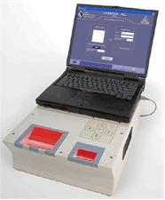
Automated Fingerprint Identification System (AFIS)
The local police agency must have a live-scan fingerprint terminal.
The agency may then:
Scan an arrestee's prints and mug shots.
Electronically transmit the prints, mug shots and personal information to their state's network for fingerprint checks.
The state agency then transmits the same information to the FBI fingerprint repository for matches.

Slide 15
Automated Fingerprint Identification System (AFIS)
Capture: a physical sample is captured by the system during enrollment.
Extraction: unique data is extracted from the sample and a mathematical template is created.
Comparison: the mathematical code is then compared with a new sample.
Match/Non-match: the system then decides if the features extracted from the new sample are a match or a non-match.

Slide 16
Fingerprint Minutia Capture
Minutia points occur where the lines of the ridges begin, end, branch off and merge with other ridge lines.
These points are mapped and a line is drawn between each point.
This creates a map of how each point relates to the other points.
The map is then stored as a data stream called a minutia template in a database for future comparison with other presented fingerprints.

Slide 17
Fingerprint Minutia Capture
It is important to note that during the entire process:
no fingerprint images are stored on the system.
a fingerprint image cannot be recreated from the minutia template.

Slide 18
AFIS Fingerprint Comparison
Latent prints can be searched against a file of 500,000 prints in one half hour.
The system produces a list of possibles called a candidate list.
This list is then checked by a qualified fingerprint examiner.

Slide 19
Biometrics
Biometrics is the automated method of recognizing a person based on a physiological (i.e. fingerprints) characteristic.
Biometric technologies are becoming the foundation of highly secure identification and personal verification systems.

Slide 20
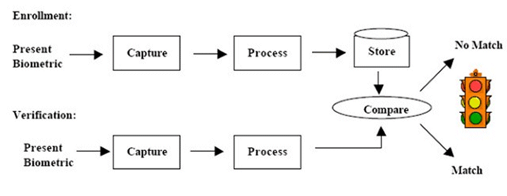
Biometrics
Biometric authentication requires comparing a stored biometric sample against a newly captured biometric sample (for example, a fingerprint captured during a login).

Slide 21
Biometrics
Danger to owners of biometrically secured items.
When thieves cannot get access to secure properties, there is a chance that the thieves will stalk and assault the property owner to gain access.
For example, in 2005, Malaysian car thieves cut off the finger of a Mercedes-Benz S-Class owner when attempting to steal the car.

Slide 22
Requirement #3
Do the following:
Name the surfaces of the body where friction or papillary ridges are found.
Name the two basic principles supporting the science of fingerprints and give a brief explanation of each principle.
Explain what it takes to positively identify a person using fingerprints.

Slide 23
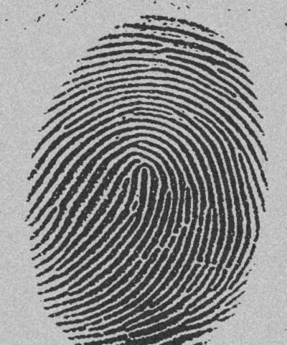
What Are Fingerprints?
Friction ridge skin pattern.
Only found on hairless parts of body such as fingers, palms, toes, and soles of feet.
Composed of ridges (hills) and furrows (valleys).
Designed by nature for firmer grip and resistance to slippage.
Black = Ridges
White = Valleys

Slide 24
Other Prints
Palm—friction ridges can be identified and may be used against suspects.

Slide 25
Other Prints
Footprints are taken at birth as a means of identification of infants.

Slide 26
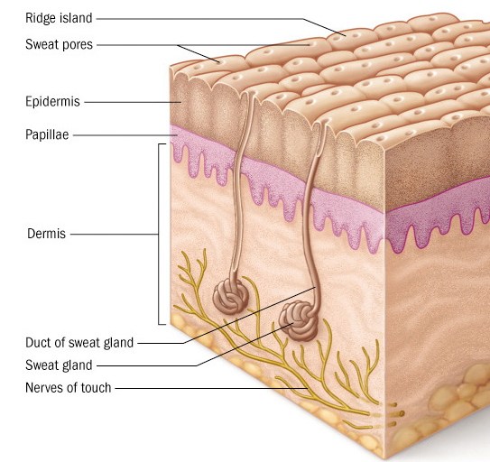
How Are Fingerprints Formed?
Skin has two layers:
Dermis
Epidermis
Between these two are the dermal papillae or basal layer.
Because the basal layer grows faster, it collapses and folds forming intricate shapes.

Slide 27
First Principal: An Individual’s Fingerprints are Unique
No two people have been found to have the same fingerprints -- they are totally unique.
There's a one in 64 billion chance that your fingerprint will match up exactly with someone else's.
Fingerprints are even more unique than DNA, the genetic material in each of our cells.
Although identical twins can share the same DNA -- or at least most of it -- they can't have the same fingerprints.

Slide 28
Second Principal: Fingerprints are Unchanged Through Life
Fingerprints begin forming by the 10th week of pregnancy.
Pattern remains unchanged throughout life.

Slide 29
Fingerprints Remain Unchanged
Impossible to alter, but there has never been a lack of trying.
To change the pattern requires obliteration of the dermal papillae (1- 2 mm deep).
Attempts to destroy pattern causes disruption, irreversibly adding more detail!

Slide 30
John Dillinger
The famous American gangster John Dillinger burnt his fingerprints off with acid - but he could have saved himself the intense pain, because they grew back.
Notes:
30

Slide 31
Scars
This permanent scar irreversibly changes the fingerprint.
It starts near the core of the loop and passes to the right of the screen.

Slide 32
How are Fingerprints Left?
Each skin ridge is populated by a single row of pores that are openings for ducts leading from the sweat glands.
Sweat glands secrete sweat to skin surface.
Sweat is necessary to form latent prints.

Slide 33
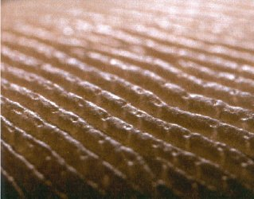

Slide 34
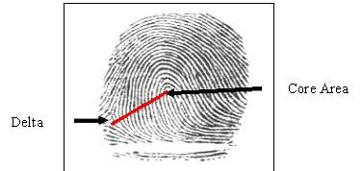
Characteristics of Fingerprints
Forensic examiners look for the presence of a core (the center of a whorl or loop) and deltas (triangular regions near a loop).
A ridge count is another characteristic that distinguishes one fingerprint from another. The count is made from the center of the core to the edge of the delta.

Slide 35
Classification of Fingerprints
Three basic patterns:
Arches
5%
Loop
65%
Whorls
30%
Racial variations (African (more arches), European (more loops), Asians/Orientals (more whorls)

Slide 36
Fingerprint Patterns - Arches
Arches are ridgelines that rise in the center to create a wavelike pattern.
They do NOT have deltas or cores.
Least common of the general patterns of fingerprints.
Two types of arches: plain (4%), like shown here and…

Slide 37
Fingerprint Patterns - Arches
Tented arch (1%)
Ends in a sharper point at the center that results in an angle that is less than 90°.

Slide 38
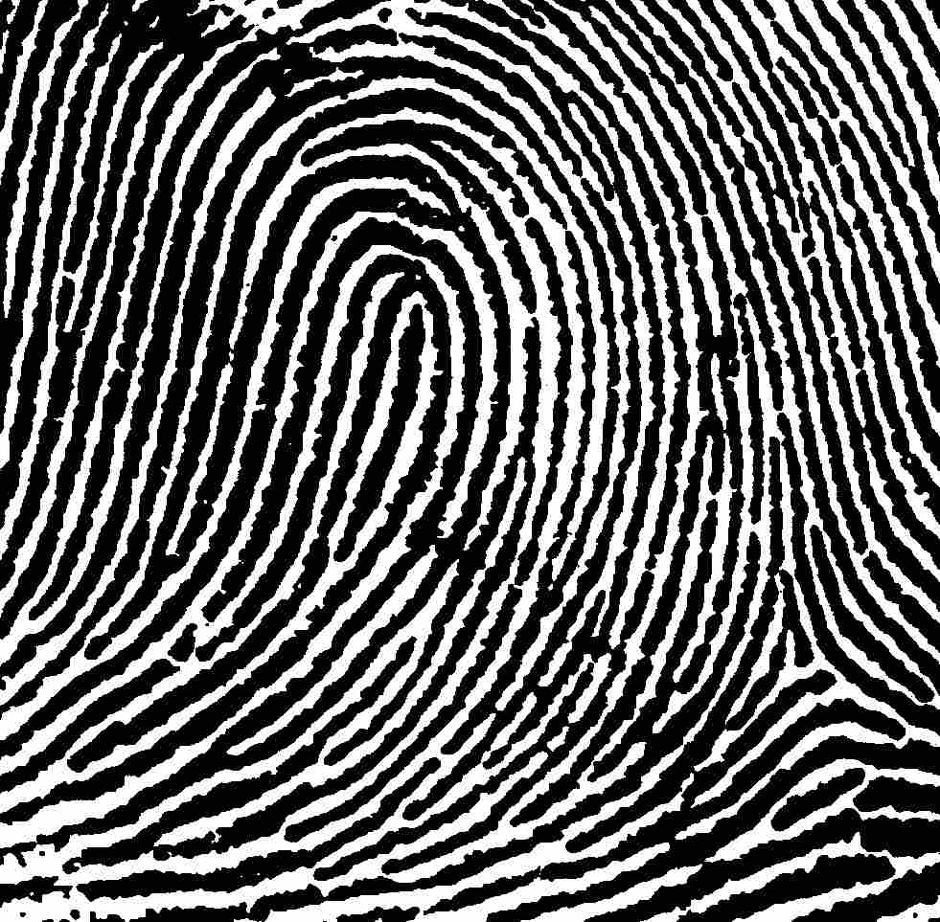
Fingerprint Patterns - Loops
A loop must have one or more ridges entering and exiting from the same side and one delta (65%).
Radial loop – loop comes from thumb side of hand.
Ulnar loop – loop comes from pinkie finger side of hand.

Slide 39
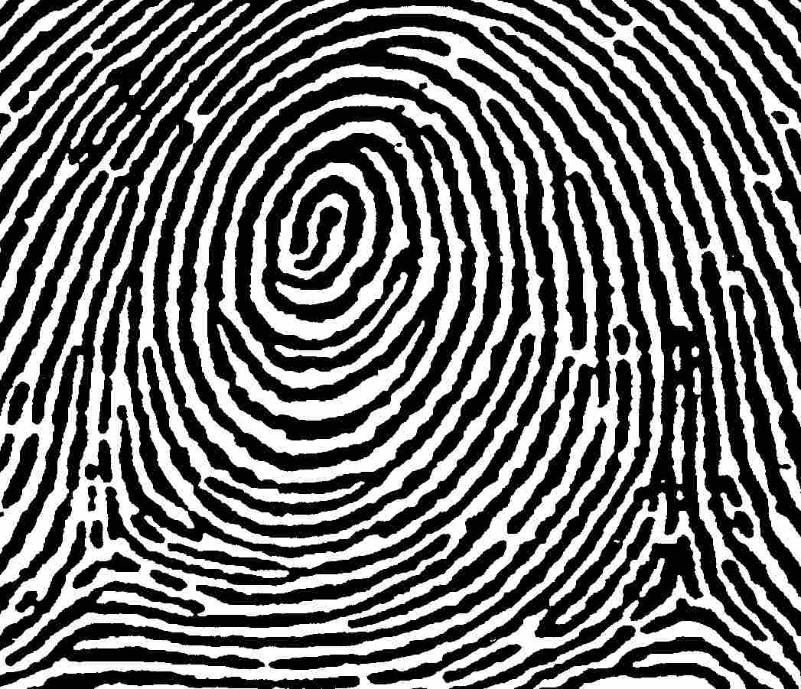
Fingerprint Patterns - Whorls
Whorls have at least two deltas and a core.
Divided into four distinct groups.
Plain
Central Pocket
Double Loop
Accidental
This is a plain whorl (24%)

Slide 40
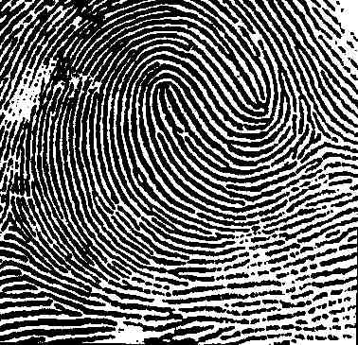
Fingerprint Patterns - Whorls
Double loop pattern (4%)
Consists of two separate loop formations, each with its own core, and two deltas.

Slide 41
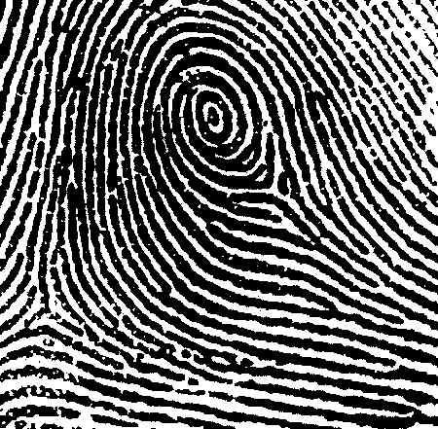
Fingerprint Patterns - Whorls
Central pocket loop is a combination of loop and whorl (2%).
It has all the characteristics of a loop, with the addition of a second delta near the core and a whorl-type ridge or ridges circuiting around the core.

Slide 42
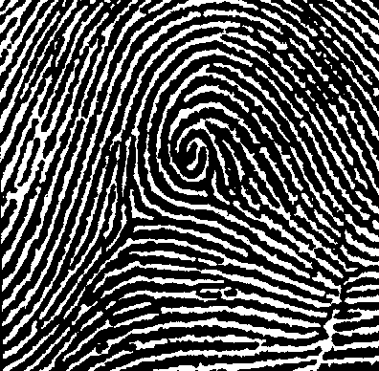
Fingerprint Patterns - Whorls
Accidental pattern will contain two or more deltas that cannot be placed into any of the other classes (0.01%).

Slide 43
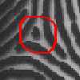
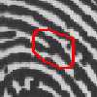
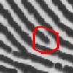
Individualization
Fingerprints are not only grouped and sub-grouped. They must be individualized.
Each individual has unique fingerprints. A fingerprint is defined by the uniqueness of the local ridge characteristics and their relationships.
Minutiae points (aka Galton’s details) are the local ridge characteristics.
Identification points consist of bifurcations, ending ridges, dots, ridges and islands.
A single rolled fingerprint may have as many as 100 or more identification points that can be used in order to identify the individual.
Island
Dot
Bifurcation
Ridge Ending

Slide 44
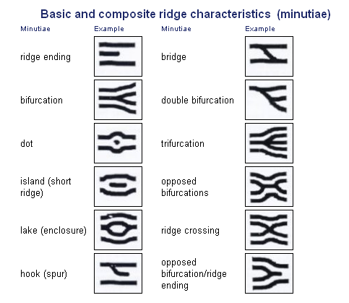
Basic and Composite Ridge Characteristics (Minutiae)

Slide 45
Can You Identify the Fingerprint Minutiae?

Slide 46
Fingerprint Minutiae

Slide 47
Individualization
Ridge Classification
Uses minutiae to individualize fingerprints
In U.S. there are no legal requirements for # of points
Criminal courts accept 8 to 12 points
150-200 minutiae in a good rolled print
Even twins have unique fingerprints due to small differences in the ridge patterns.

Slide 48
Fingerprint Matching Process
The fingerprint matching process involves looking for identical minutiae in identical locations on each fingerprint.
These are known as corresponding minutiae.

Slide 49
Fingerprints Are Not Infallible
Brandon Mayfield is an American lawyer identified as a participant in the Madrid bombing based on a fingerprint match.
The FBI Latent Print Unit ran the print collected in Madrid and reported a match against one of 20 fingerprint candidates returned in a search response from their IAFIS—Integrated Automated Fingerprint Identification System.
The FBI initially called the match "100 percent positive" and an "absolutely incontrovertible match".

Slide 50
Brandon Mayfield and the Madrid Bombing
The Spanish National Police examiners concluded the prints did not match Mayfield, and after two weeks identified another man who matched.
The FBI acknowledged the error, and a judge released Mayfield after two weeks in May 2004.
In January of 2006, a U.S. Justice Department report was released which faulted the FBI for sloppy work but exonerated them of more serious allegations.
The report found that misidentification was due to misapplication of methodology by the examiners involved: Mayfield is an American-born convert to Islam and his wife is an Egyptian immigrant, not factors that affect fingerprint search technology.

Slide 51
Requirements #4 and #5
Requirement #4
Take a clear set of prints using ONE of the following methods:
Make both rolled and plain impressions. Make these on an 8-by-8-inch fingerprint identification card available from your local police department or counselor.
Using clear adhesive tape, a pencil, and plain paper, record your own fingerprints or those of another person.
Requirement #5
Show your merit badge counselor you can identify the three basic types of fingerprint patterns and their subcategories. Using your own hand, identify the types of patterns you see.

Slide 52
Balloon Prints
Materials: White latex balloons, Fingerprinting pad
Procedure
Partially inflate a balloon. Do not tie it off.
Open fingerprinting pad and gently roll one fingertip.
Apply finger to balloon surface, being careful not to smudge or twist while lifting the finger from the balloon surface.
Inflate balloon enough to view expanded details of the print. Is the print an arch, loop, or whorl?
Examine print for quality and resolution of ridge detail, including minutae.

Slide 53
Inked Prints
Materials: Fingerprinting ink pad, white paper or ten card
Procedure
On a sheet of scrap paper, practice rolling your lab part­ner's prints.
Cover your partner's finger with a thin coat of ink from the crease at the first knuckle to the very top.
When rolling onto the paper, make one pass in a smooth, even motion. Roll nailbed to nailbed. Do not roll back and forth!
When you feel comfortable with your technique, roll a full set of prints onto the following squares. Be sure that both you and your partner wash your hands before beginning the final version.
Roll each finger, one at a time, onto the inked print data sheet.

Slide 54
Fingerprinting Merit Badge

